Slide 1

Snowflake
Overview of Key Innovations

Slide 2
Core Architectural Innovations
Separation of Storage & Compute
Snowflake's unique multi-cluster shared data architecture separates storage from compute, allowing enterprises to scale resources independently while maintaining a single, secure source of truth.
Unlike legacy databases where you pay for a bundled package of disk space and CPU power, Snowflake lets you scale these independently — if you have petabytes of data but only run occasional queries,
You pay only for the storage and the specific seconds your queries are active
Elastic Compute & Storage

Slide 3
Core Architectural Innovations
Zero-Copy Cloning
You can create an identical copy of a multi-terabyte database in seconds without actually duplicating the data or incurring additional storage costs
A game-changer for DevOps and data engineering that allows for rapid testing and development in isolated environments.
Multi-Cloud Support
Snowflake runs natively on
AWS
Azure
Google Cloud
Enabling cross-cloud interoperability without vendor lock-in.

Slide 4
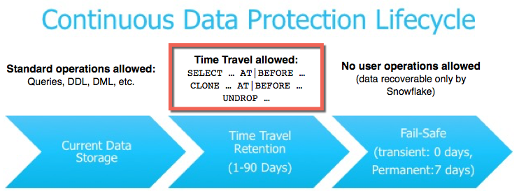
Core Architectural Innovations
Time Travel
Snowflake Time Travel enables accessing historical data (data that has been changed or deleted) at any point within a defined period.
Restoring objects that might have been accidentally or intentionally deleted. You can restore individual objects, such as tables, or restore all the objects inside a container object by restoring an entire schema or database.
Duplicating and backing up data from key points in the past.
Analyzing data usage/manipulation over specified periods of time.

Slide 5
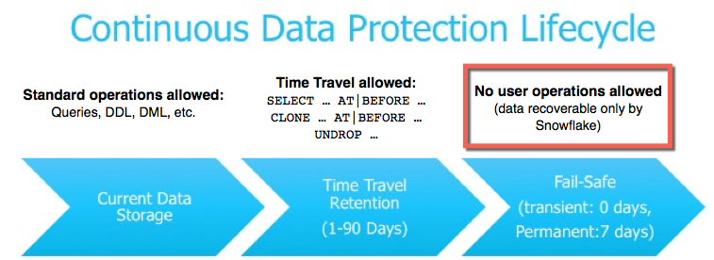
Core Architectural Innovations
Fail-safe
Fail-safe ensures historical data is protected in the event of a system failure or other event (e.g. a security breach).
Fail-safe provides a (non-configurable) 7-day period during which historical data may be recoverable by Snowflake.

Slide 6
Core Architectural Innovations
Secure Data Sharing
With Secure Data Sharing, no actual data is copied or transferred between accounts. All sharing uses Snowflake’s services layer and metadata store.
Shared data does not take up any storage in a consumer account and therefore does not contribute to the consumer’s monthly data storage charges.
The only charges to consumers are for the compute resources (i.e. virtual warehouses) used to query the imported data.
Views
Cortex Search services
User-defined functions (UDFs) (secure and non-secure)
Models of type USER_MODEL, CORTEX_FINETUNED, or DOC_AI
Databases
Tables
Dynamic tables
External tables
Externally managed and managed Apache Iceberg™ tables
Externally managed Delta Lake tables

Slide 7
Core Architectural Innovations
•Native Support for Multiple Data Types
Snowflake's native type support spans four broad families:
Structured types are your standard relational building blocks — numbers, strings, booleans, and binary. Nothing exotic here, but Snowflake handles precision exactly (e.g. NUMBER(38, 18)) with no silent rounding.
Semi-structured types are where Snowflake really differentiates itself. VARIANT can hold any JSON, Avro, ORC, or Parquet value and stores it internally as compressed columnar data. You query nested fields with dot-notation (col:field.subfield) or bracket syntax, and Snowflake's optimizer can even "prune" to just the nested paths you touch — no full document scan needed.

Slide 8
Core Architectural Innovations
•Native Support for Multiple Data Types
Date & time gives you three flavors of timestamp: NTZ (no timezone, just a wall-clock moment), LTZ (stored in UTC, displayed in the session timezone), and TZ (stores the original offset alongside the value). All support up to nanosecond precision.
Geospatial types (GEOGRAPHY and GEOMETRY) are first-class citizens since 2020. GEOGRAPHY uses the WGS84 spherical model (real-world coordinates), while GEOMETRY works on a flat Euclidean plane. Both accept GeoJSON, WKT, or WKB as input and expose the standard ST_* function library (ST_DISTANCE, ST_WITHIN, ST_INTERSECTS, etc.) — no PostGIS extension needed.
The practical payoff: you can join a JSON event log, a geofence polygon, and a timestamp range in a single query, with all three types stored natively in columnar format and compressed on disk.

Slide 9
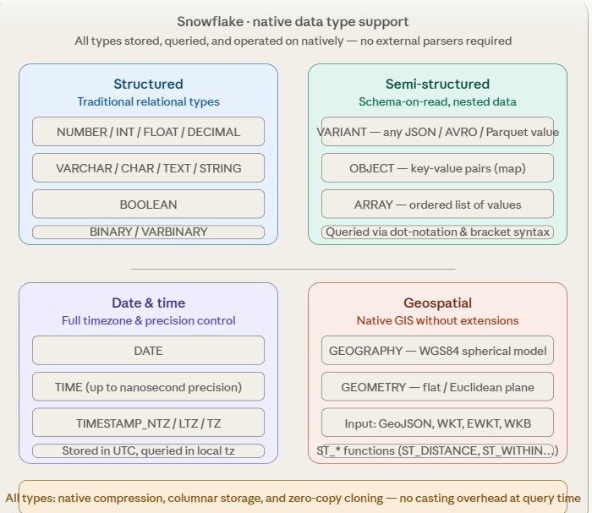
Core Architectural Innovations

Slide 10
AI & Cortex Innovations
• Cortex AI (AI in SQL)
Cortex AI Functions let users run unstructured analytics on text and images with industry-leading LLMs from OpenAI, Anthropic, Meta, Mistral AI, and DeepSeek
All accessible via standard SQL or Python, right inside Snowflake
Snowflake CoWork & CoCo (AI Agents)
Snowflake announced 26+ new capabilities at Summit 2026 spanning AI agents and productivity (CoWork, CoCo), context and semantics, security and governance, infrastructure and interoperability, and AI infrastructure.
CoWork is the personal AI agent for knowledge workers, while CoCo (formerly Cortex Code) is a data-native AI coding agent.

Slide 11
AI & Cortex Innovations
• Cortex Training
Snowflake introduced 430+ new capabilities in fiscal 2026, including Cortex Code, a cutting-edge AI coding agent
Along with expanded partnerships with Anthropic, Google Cloud, and OpenAI for native access to leading foundation models.

Slide 12
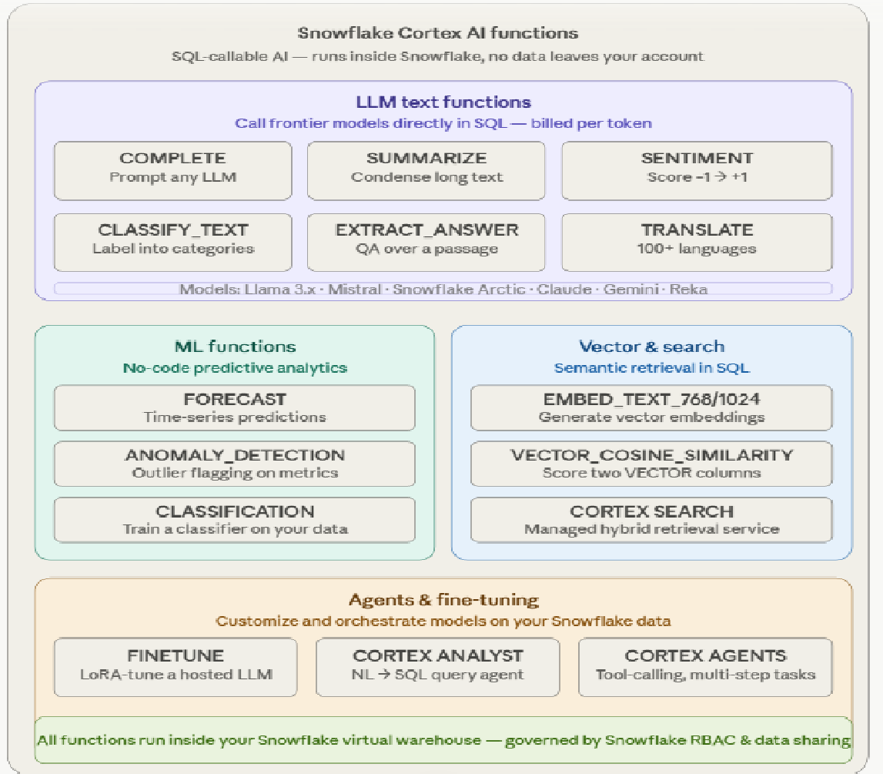
AI & Cortex Innovations

Slide 13
Streaming & Real-Time Features
•Snowpipe
Snowpipe enables loading data from files as soon as they’re available in a stage.
This means you can load data from files in micro-batches, making it available to users within minutes.
Rather than manually executing COPY statements on a schedule to load larger batches.

Slide 14
Streaming & Real-Time Features
•Snowpipe Streaming
Snowpipe Streaming is Snowflake’s real-time ingestion service built on the high-performance architecture.
It enables applications to load streaming data directly into Snowflake tables as rows arrive, without staging files or managing intermediate storage.
Data becomes available for query within seconds of ingestion, supporting use cases from IoT telemetry and Change Data Capture (CDC) pipelines to fraud detection and live analytics.
Up to 10 GB/s throughput per table
As low as 5 second end-to-end ingest-to-query latency
Exactly-once delivery through built-in offset token tracking
Ordered ingestion within each channel
Streaming into Snowflake-managed Apache Iceberg tables

Slide 15
Security & Governance
AI Guardrails & Agent Identity
Snowflake announced agent identity (so you can tell when activity is happening in an agentic context and apply different policies), data movement policies, multi-party approvals for sensitive operations, and AI guardrails for CoCo and CoWork. SQLYARD
Natoma Acquisition (MCP Governance)
Snowflake announced its intent to acquire Natoma, an enterprise MCP platform that provides a centralized MCP gateway enforcing identity verification, access policies, and audit controls at the tool-call level — governing what actions AI agents can take.

Slide 16
Open Lakehouse & Apache Iceberg Support
Snowflake's Open Lakehouse story is built around one core idea: your data files live in your cloud storage bucket (S3, GCS, or ADLS), in open Parquet format, governed by the Apache Iceberg spec — and Snowflake treats them as first-class tables.
The Iceberg format itself has three layers: Parquet data files at the bottom, JSON manifest/snapshot metadata files in the middle, and a catalog pointer at the top that tracks which snapshot is "current." Any engine that speaks Iceberg can read all three layers without touching Snowflake.

Slide 17
Open Lakehouse & Apache Iceberg Support
Two usage modes let you pick who drives writes:
Snowflake-managed Iceberg tables — Snowflake writes the Parquet and metadata to your bucket. You get full DML (INSERT, UPDATE, DELETE, MERGE), ACID transactions, time travel, and auto-clustering. Other engines (Spark, Trino, Flink) can read the same files directly.
External Iceberg tables — Snowflake reads files that another engine wrote. You get full SQL query capability with predicate and projection pushdown. You periodically call ALTER ICEBERG TABLE … REFRESH to sync Snowflake's view to the latest Iceberg snapshot.
Catalog integrations mean Snowflake isn't opinionated about where table metadata lives. It can act as the catalog itself (backed by Polaris, Snowflake's open-source catalog), or connect to AWS Glue, Databricks Unity Catalog, Apache Polaris, Project Nessie, or any REST-compatible Iceberg catalog.

Slide 18
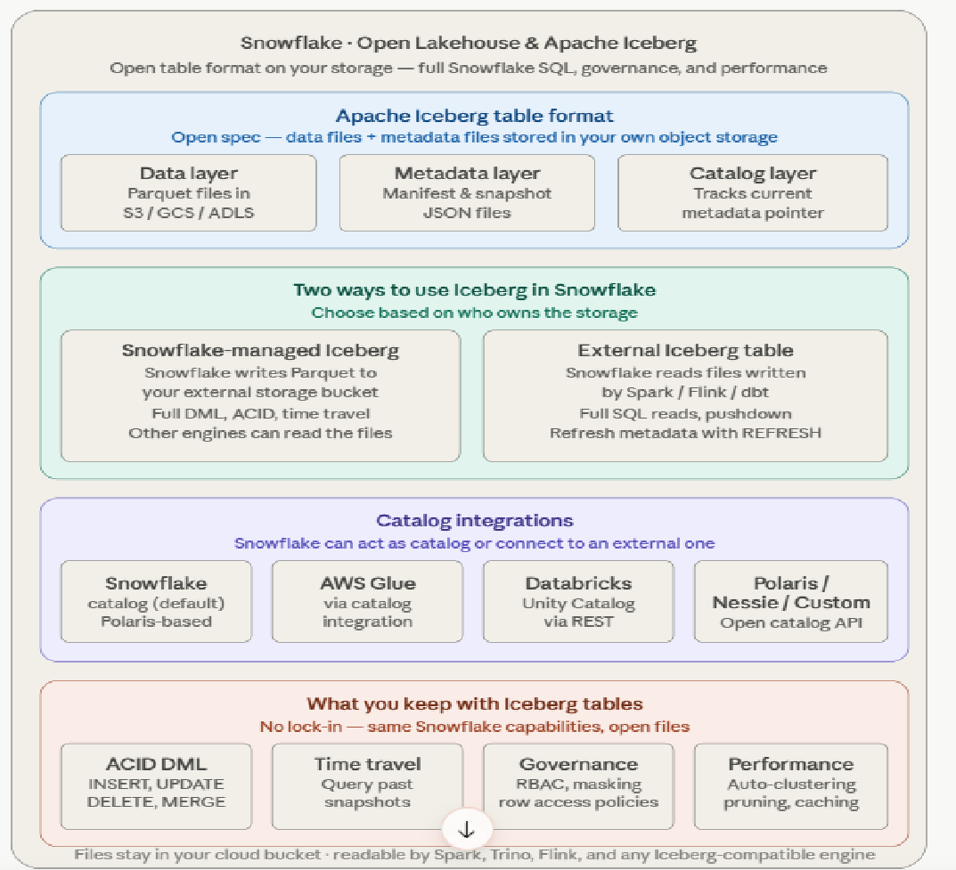
Open Lakehouse & Apache Iceberg Support

Slide 19
Container & App Development Features
Everything — containers, apps, UDFs, Streamlit — is governed by the same RBAC model and observable through event tables, and deployable via CI/CD using SnowCLI.
Four layers make up Snowflake's app development platform:
Snowpark Container Services (SPCS) is the infrastructure foundation.
You push any Docker image to Snowflake's image registry and run it on managed compute pools — CPU for general workloads, GPU nodes (up to A10G / A100) for ML inference and training.
Two execution modes: services are long-running containers (REST APIs, model servers, dashboards) with Snowflake-managed health checks and automatic restarts; jobs are batch/one-shot containers triggered by SQL or Tasks, useful for training runs or heavy data processing.
Logs stream to an event table so you can query them with SQL.

Slide 20
Container & App Development Features
Native Apps Framework is the distribution layer.
You bundle SQL objects, Streamlit UIs, SPCS services, and Python UDFs into a versioned application package, list it on the Snowflake Marketplace, and consumers install it into their own account with one click.
The key governance property: the consumer's data never leaves their account, and the provider's proprietary logic is never exposed — each side sees only what they're meant to see.

Slide 21
Container & App Development Features
Streamlit in Snowflake gives you Python data apps without any web hosting.
You write Streamlit code in the Snowsight browser IDE, and the app connects to Snowflake using the caller's RBAC identity automatically — no connection strings, no secrets.
Apps can be shared to specific roles within an account, or embedded directly inside a Native App as the UI layer.

Slide 22
Container & App Development Features
Extensibility primitives let you push custom logic into the SQL engine itself.
UDFs handle scalar transformations (Python, Java, Scala, JS, SQL).
UDTFs return rows — useful for parsing, exploding, or generating data.
Stored procedures expose the full Snowpark DataFrame API for complex procedural logic.
Service functions are the newest primitive: they let you call an SPCS HTTP endpoint directly from a SQL expression, which is how you embed a custom ML model or external API into a query without leaving Snowflake.

Slide 23
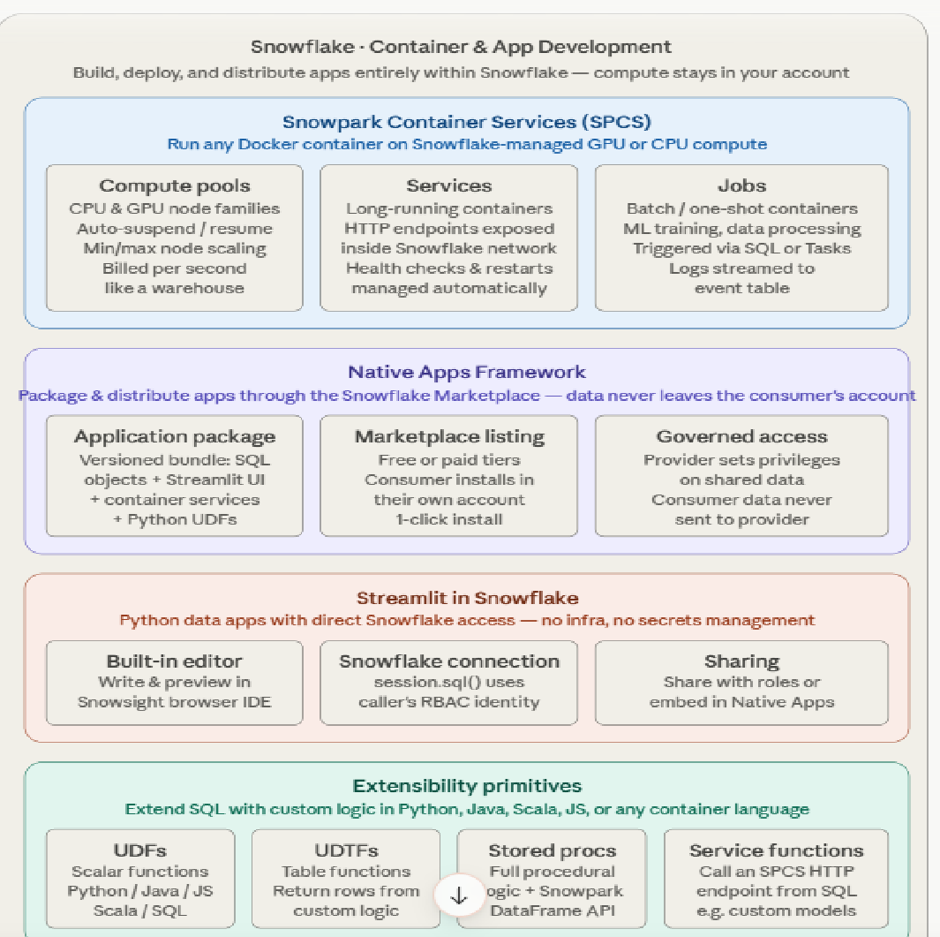
Container & App Development Features

Slide 24
Advanced Analytics & ML
Feature Store solves the training/serving skew problem —
The gap between features used in training and features computed at inference time.
You define entities (the join key, e.g. user_id) and feature views (the SQL or Snowpark logic that computes features).
Views are versioned Snowflake objects, kept fresh via Dynamic Tables on a schedule you control.
At training time, generate_training_set() produces a point-in-time correct dataset — it joins features to labels as they existed at the label timestamp, preventing future leakage.
At inference time, retrieve_feature_values() fetches the same features for live scoring, guaranteeing consistency.

Slide 25
Advanced Analytics & ML
Vector data support gives embeddings a home inside Snowflake's columnar engine.
The native VECTOR(FLOAT, N) type stores up to 4096-dimensional vectors with compression, alongside three distance functions: cosine similarity, L2 distance, and inner product. A full RAG pipeline fits in pure SQL: EMBED_TEXT → store as VECTOR column → rank by similarity → pipe top-K chunks into COMPLETE.
Cortex Search is a managed service on top of this for production retrieval without hand-rolling the index.

Slide 26
Advanced Analytics & ML
Model Registry is where trained models land after experimentation.
You log any framework (scikit-learn, XGBoost, PyTorch, Hugging Face, MLflow-compatible) with metrics, parameters, and tags that are stored as first-class Snowflake objects — queryable via SQL
Deployment is a one-line call: models can be deployed as warehouse-based UDFs for batch scoring (SELECT model!PREDICT(features)), or as SPCS services for low-latency real-time inference.
No external model server to provision or maintain.
Semantic Views are a metadata layer that attaches business meaning to physical tables — defining metrics (revenue, DAU), dimensions (region, product line), valid join paths, and plain-English synonyms for column names. This layer is what Cortex Analyst reads when it interprets a natural language question: instead of guessing table structure from a prompt, the model reasons against the semantic definition you've already validated. BI tools like Tableau, Power BI, and Sigma can also consume semantic views, making it a true single source of metric truth across both AI and human-driven analytics.

Slide 27
Advanced Analytics & ML
Semantic Views are a metadata layer that attaches business meaning to physical tables —
Defining metrics (revenue, DAU), dimensions (region, product line), valid join paths, and plain-English synonyms for column names.
This layer is what Cortex Analyst reads when it interprets a natural language question: instead of guessing table structure from a prompt, the model reasons against the semantic definition you've already validated. BI tools like Tableau, Power BI, and Sigma can also consume semantic views, making it a true single source of metric truth across both AI and human-driven analytics.

Slide 28
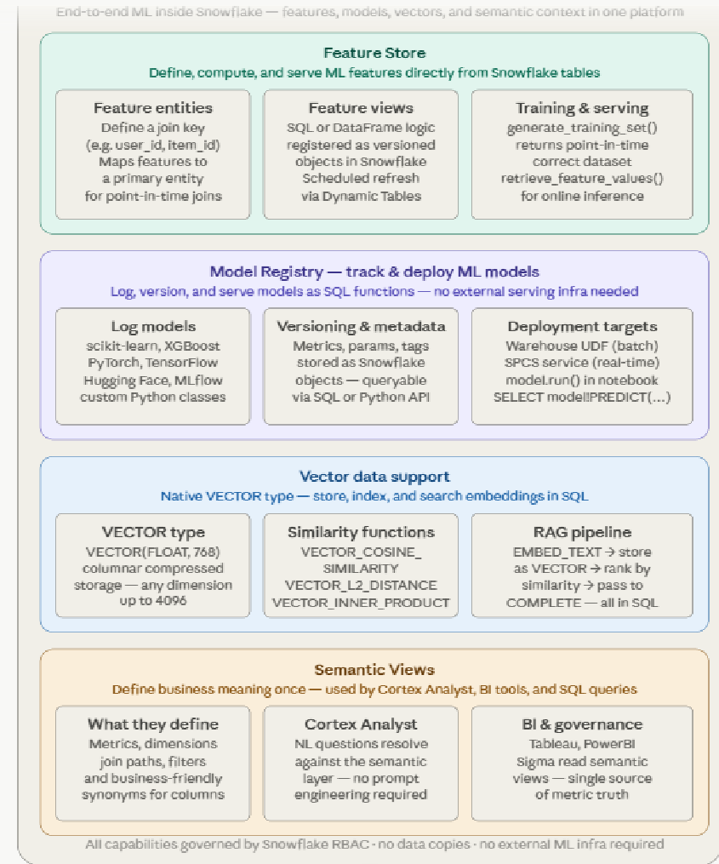
Advanced Analytics & ML

Slide 29
Collaboration & Marketplace
Snowflake's collaboration model is built on one architectural principle: data never moves. Sharing is a metadata operation — the consumer's warehouse queries the provider's storage directly, in real time.
Secure Data Sharing is the foundation.
A provider creates a Share object and adds tables, secure views, UDFs, or Iceberg tables to it.
The consumer creates a read-only database from that Share in their own account — it looks and queries exactly like a local database, but the data lives entirely in the provider's storage.
Cross-cloud and cross-region shares are supported via Snowflake's internal replication layer.
The cost split is clean: the provider pays for storage, the consumer pays for the compute they use to query it.


Slide 30
Collaboration & Marketplace
Snowflake Marketplace is the distribution channel built on top of sharing.
Over 3,000 live data products from 500+ providers — financial data (Refinitiv, S&P), weather (Tomorrow.io), geospatial (HERE, SafeGraph), identity (LiveRamp), health, ESG signals, and more. Crucially, these are live datasets, not downloaded exports — when the provider updates their data, consumers see it immediately.
Native Apps on the Marketplace work differently: the ISV's code runs inside your account against your data, so the provider never sees your records.


Slide 31
Collaboration & Marketplace
Data Clean Rooms are the privacy-preserving layer for sensitive multi-party collaboration —
The headline use case is ad-tech audience overlap (a retailer and a media company want to know how much their customer bases overlap without sharing raw customer lists).
Each party brings data to a shared environment, but the provider pre-defines the only SQL query templates that are allowed to run.
Results are returned with differential privacy or k-anonymity thresholds enforced, so neither party can reverse-engineer the other's raw records from the output.


Slide 32
Collaboration & Marketplace
Collaboration primitives round out the toolkit:
Reader Accounts let you share with organizations that don't have Snowflake — Snowflake provisions a managed account on their behalf. Private listings are targeted B2B data products delivered to specific named accounts.
Cross-cloud sharing works across AWS, Azure, and GCP without the consumer knowing or caring which cloud the provider is on.
And Snowsight includes request/approval workflows so data access can be governed through a UI rather than just SQL DDL.

